Slide 1
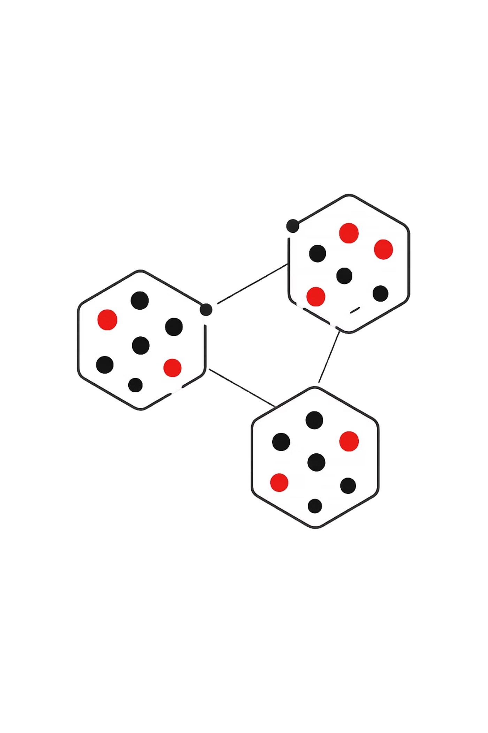
Cluster Analysis
Partitioning Methods & Hierarchical Clustering
DATA MINING
JIYA CHAUDHARY
RA2311003030560
BTECH CSE CORE I

Slide 2
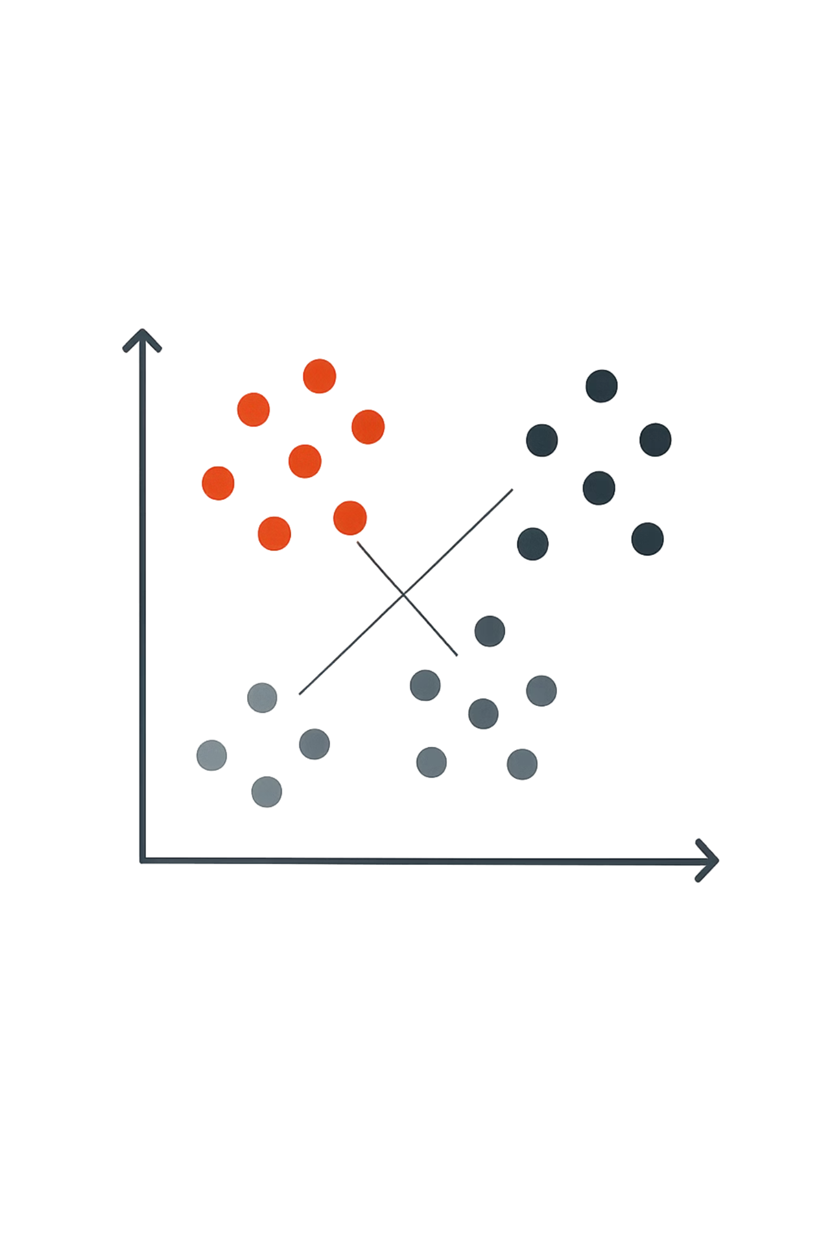
What is Cluster Analysis?
Cluster analysis groups similar data points together — objects in the same cluster are more alike to each other than to those in other clusters. No labels required.
Customer Segmentation
Group customers by behaviour or preferences for targeted marketing.
Image Processing
Segment pixels to identify regions or compress images.
Pattern Recognition
Discover hidden structures in complex datasets.

Slide 3
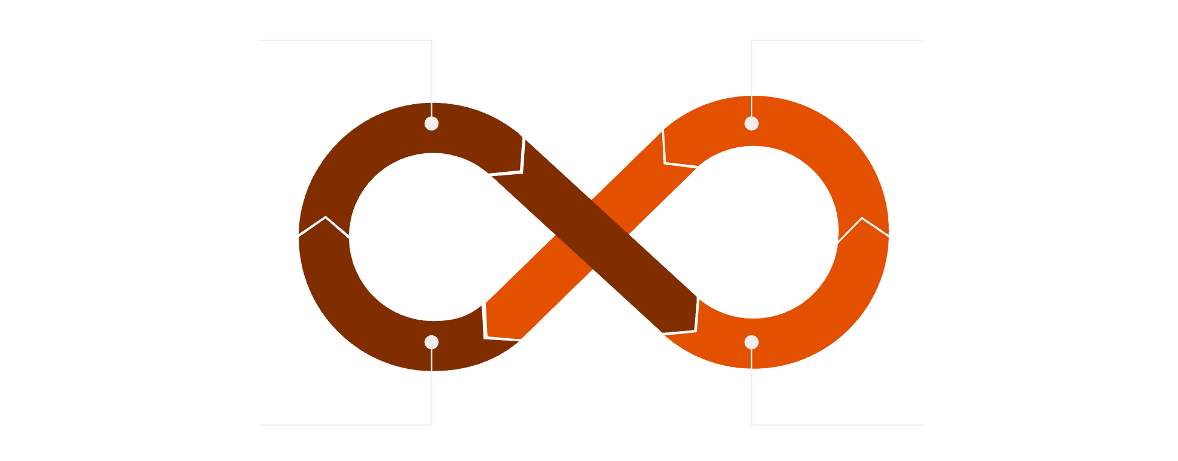
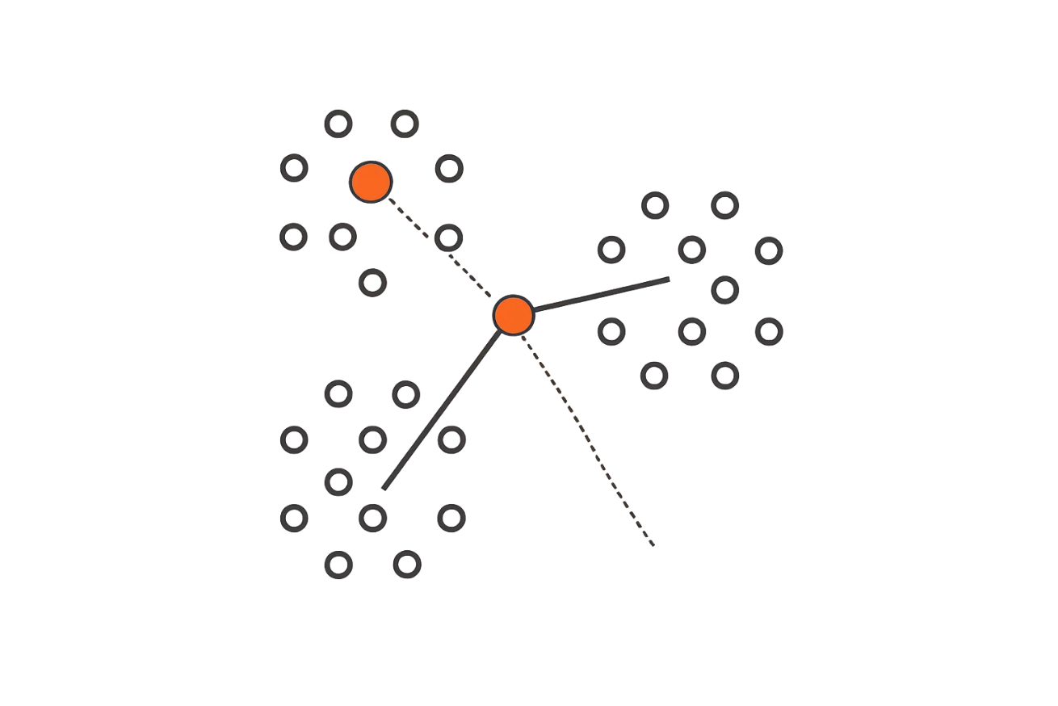
Partitioning Methods
Partitioning methods divide data into K distinct clusters, where each object belongs to exactly one cluster. The number of clusters, K, must be specified in advance.
Assign to Nearest Centroid
Recalculate Centroids
Repeat Until Stable
Check for Convergence
The K-Means algorithm repeats these steps until cluster assignments stabilise — a fast, iterative approach well-suited to large datasets.
Requires K in Advance
You must decide the number of clusters before running the algorithm.
Iterative Refinement
Centroids shift with each iteration until the solution converges.

Slide 4
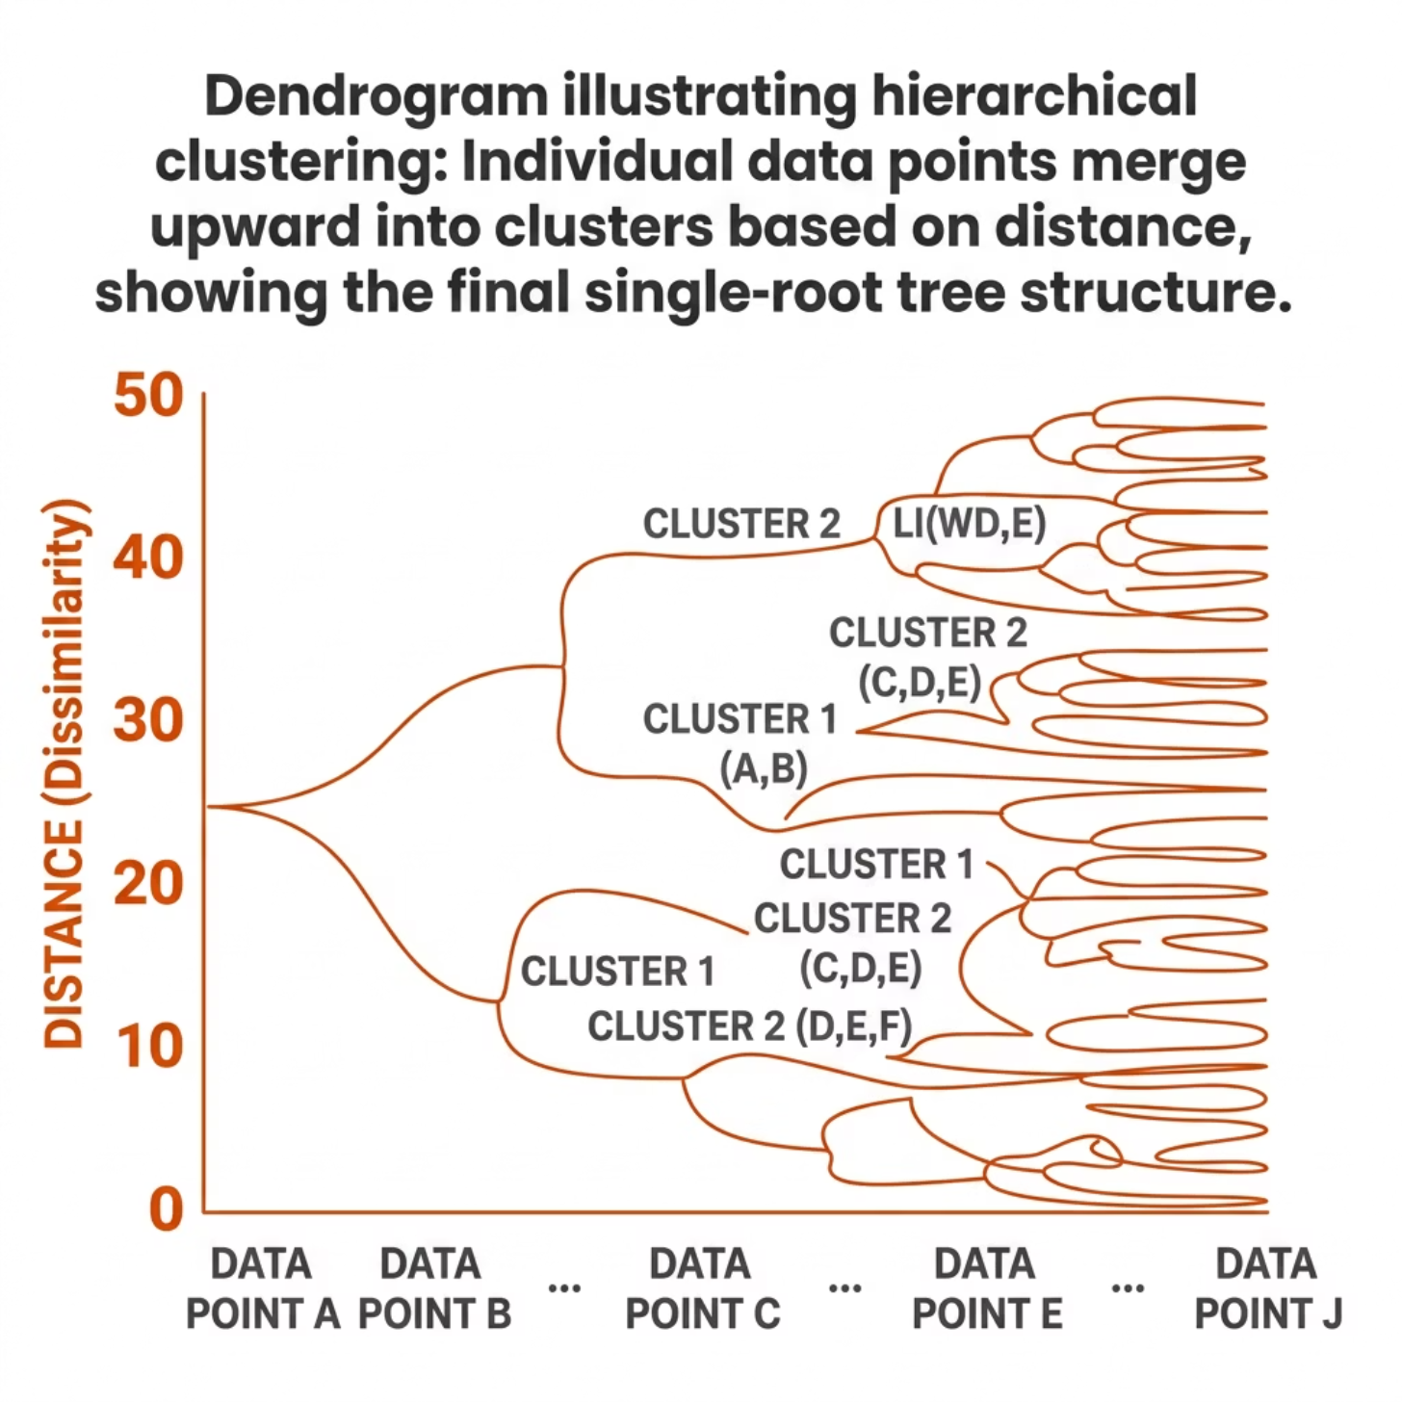


Hierarchical Clustering
Hierarchical clustering builds a tree-like structure called a dendrogram, revealing how clusters merge or split at different levels — no need to pre-specify K.
Two Approaches
Agglomerative
Divisive
Bottom-Up: Start with individual points and merge the closest clusters step by step.
Top-Down: Start with one big cluster and split it recursively.
Cut the dendrogram at any height to obtain the desired number of clusters.

Slide 5
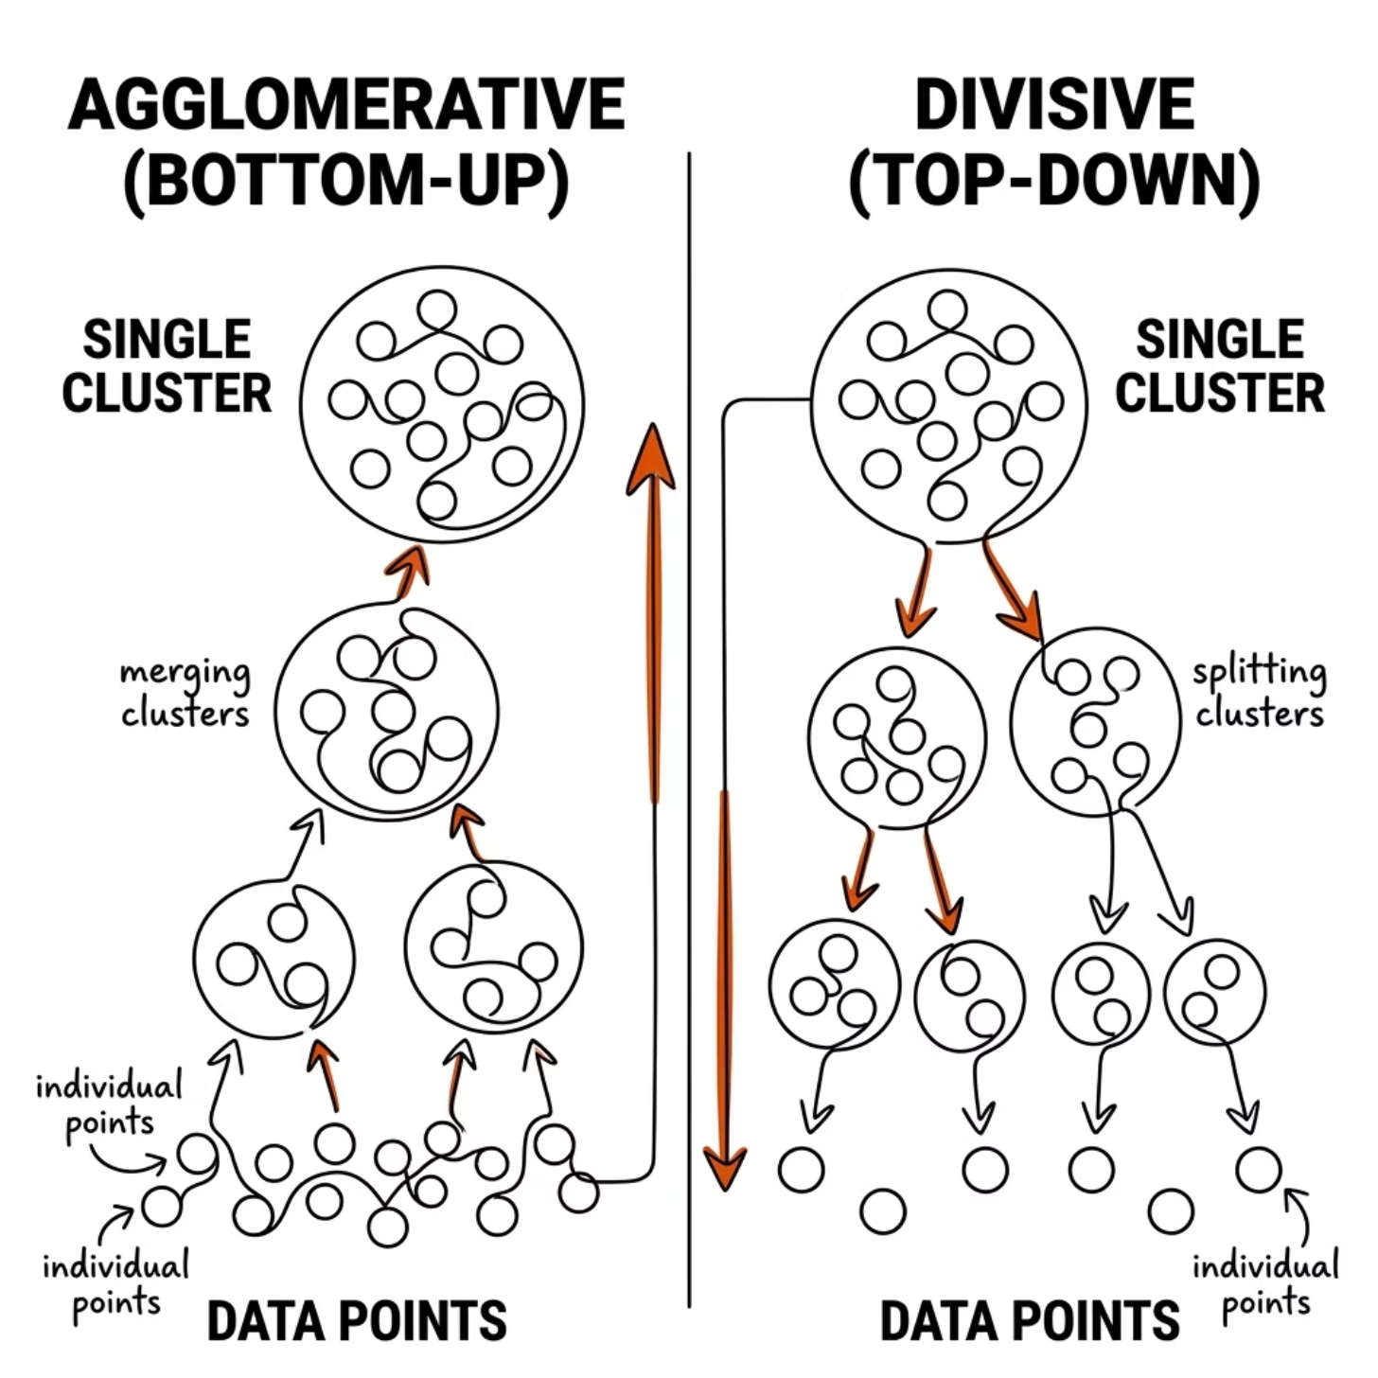
Agglomerative vs Divisive
Both methods produce a dendrogram but work in opposite directions. Agglomerative is far more common in practice due to its simplicity and efficiency.
Agglomerative — Bottom-Up
Divisive — Top-Down
Start with all points in one cluster
Split the least cohesive cluster at each step
Continue until each point is alone
Computationally more expensive
Start with each point as its own cluster
Merge the two closest clusters at each step
Continue until one cluster remains
More commonly used in practice

Slide 6
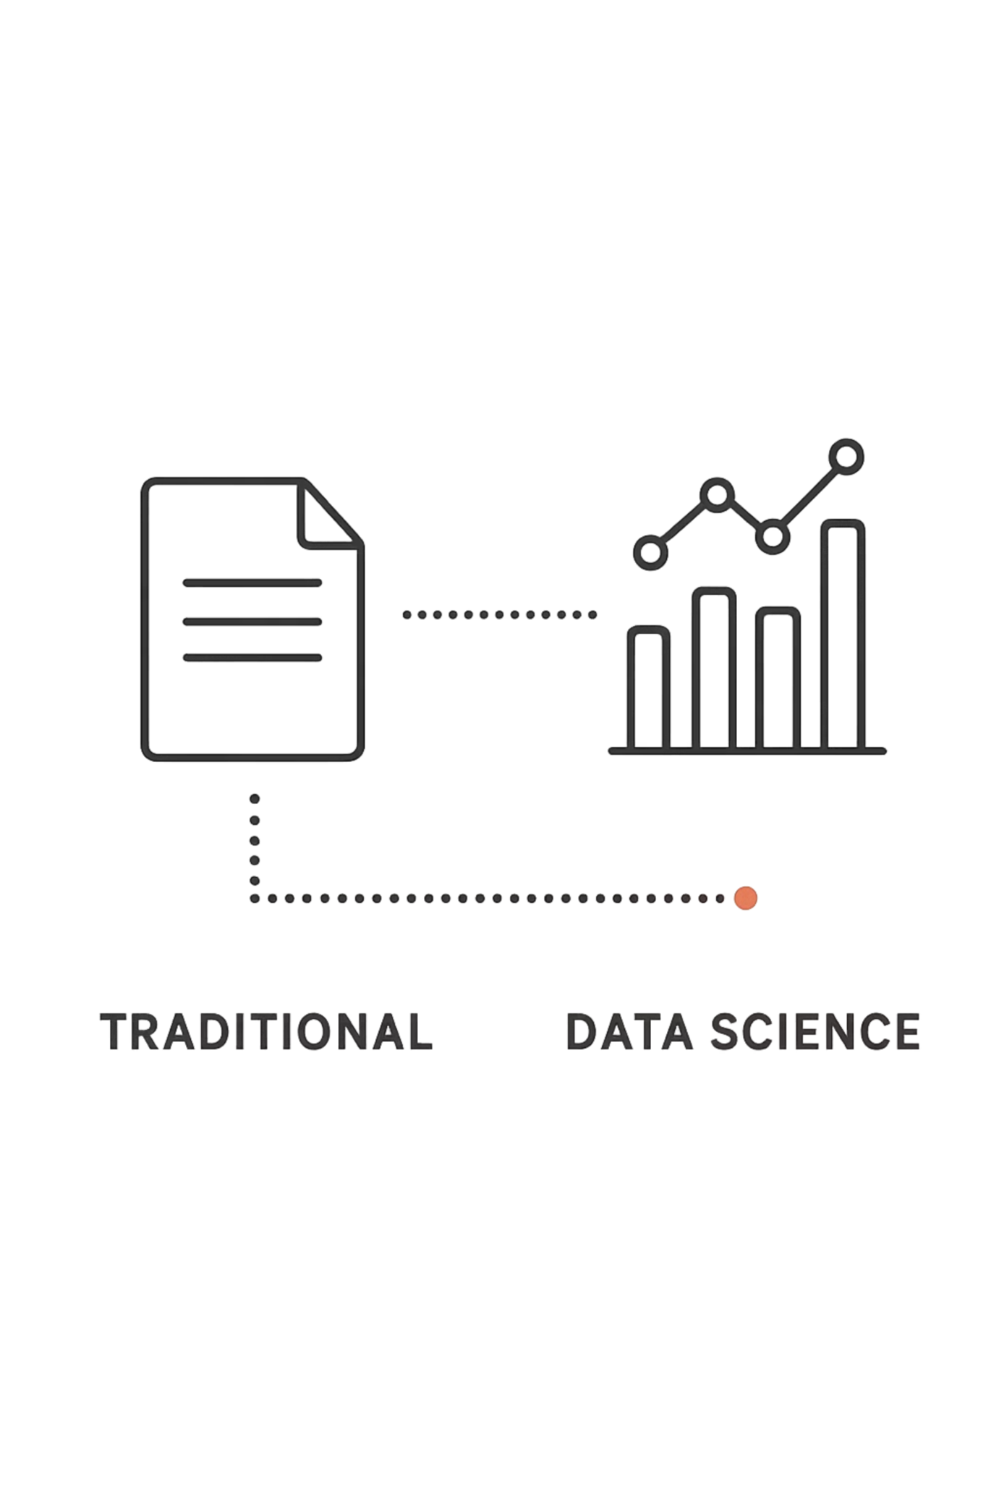

Comparison & Summary
Choose the right method based on your dataset size and analytical goals.
Partitioning Methods
Fast and scalable for large datasets
Requires K to be specified upfront
Produces flat, non-overlapping clusters
Best for: Customer segmentation, quick clustering
Hierarchical Clustering
Flexible — no K required in advance
Reveals detailed cluster structure via dendrogram
Computationally heavier for large datasets
Best for: Exploratory analysis, small-to-medium data
Key Takeaway: Use partitioning for speed and scale; use hierarchical when you need to understand the relationships between clusters.

